Slide 1


Internship Project
AI/ML – Healthcare Prediction on
Diabetic Patients using Python

Slide 2

Student Name : Kanakamahalakshmi katepalli
Student ID : STU61cddee2864c01640881890
College Name : Kakinada Institute of Engineering and Technology for Women

Slide 3
CAPSTONE PROJECT SHOWCASE
Project Title
AI/ML – Healthcare Prediction on Diabetic Patients using Python
Abstract | Problem Statement | Project Overview | Proposed Solution | Technology Used | Modelling & Results | Conclusion

Slide 4
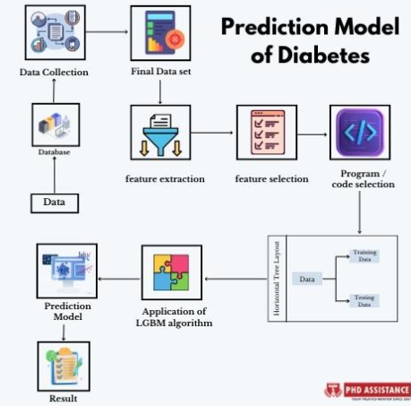
Abstract
Diabetes is a chronic condition affecting millions of individuals worldwide, posing significant challenges to healthcare systems. Early prediction and management are essential to improve patient outcomes and reduce healthcare costs. This project leverages AI/ML techniques to develop a predictive model that identifies the likelihood of diabetes-related complications in patients using Python.
By utilizing patient data, such as glucose levels, BMI, blood pressure, and other clinical indicators, the system employs machine learning algorithms to analyze patterns and predict health risks. The project showcases an end-to-end pipeline, from data preprocessing and feature selection to model training, evaluation, and deployment. Models like Random Forest, Logistic Regression, and Neural Networks are explored to ensure accuracy and robustness.
Fig 1 : Prediction Model of Diabetes
Source: https://www.phdassistance.com/blog/methods-of-big-data-analysis-to-predict-diabetes-diseases/

Slide 5
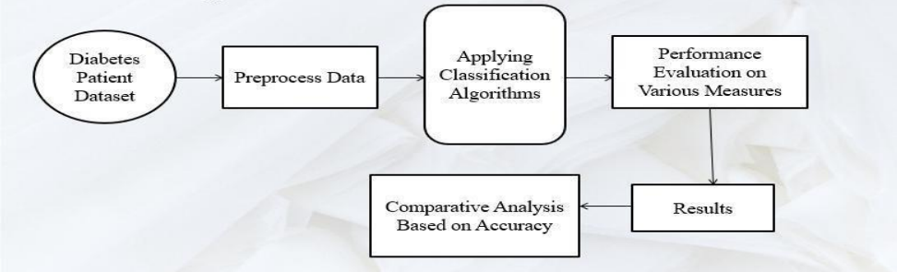
Problem Statement
Build a model with high accuracy to predict whether patients in the dataset have diabetes.
Fig 2 : Diabetes Prediction Model Life Cycle
Source: https://www.ijniet.org/wp-content/uploads/2024/05/290.pdf

Slide 6
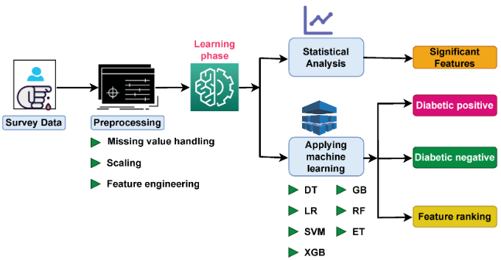
Project Overview
This dataset is originally from the National Institute of Diabetes and Digestive and Kidney Diseases.
The objective of the dataset is to diagnostically predict whether or not a patient has diabetes, based on certain diagnostic measurements included in the dataset. Several constraints were placed on the selection of these instances from a larger database.
In particular, all patients here are females at least 21 years old of Pima Indian heritage.
Fig 3 : Workflow of the Project
Source: https://www.mdpi.com/2078-2489/14/7/376

Slide 7
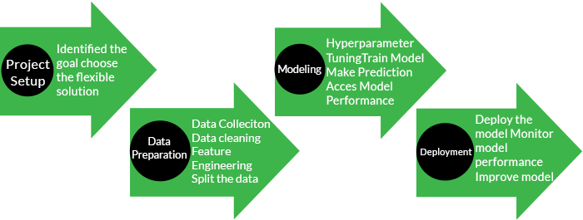
Proposed Solution
Fig 4 : Sequential Process flow in Machine Learning
Source: https://www.tutorialspoint.com/machine_learning/index.htm

Slide 8
Proposed Solution
Building a machine learning-based predictive system to assess the likelihood of diabetes-related health complications in patients.
Data Collection and Preprocessing: Collect patient datasets (e.g., glucose levels, BMI, blood pressure), clean and normalize data, handle missing values.
Model Selection and Training: Use algorithms like Logistic Regression, Random Forest, etc. to compare performance using metrics like accuracy and F1-score.
Implementation: Create an end-to-end pipeline for data ingestion, model training, and prediction and optimize hyperparameters for better performance.
Interpretability: Analyze feature importance to explain model decisions and provide actionable insights.
Deployment: Future development includes of making a user-friendly interface or API for healthcare professionals to input data and get predictions.
This solution ensures accuracy, interpretability, and ease of use to support better patient care and outcomes.

Slide 9




Technology Used
Python enables users to implement AI solutions easily, even without extensive programming knowledge.
Libraries Used :
Seaborn
NumPy
Pandas
Scikit Learn
Matplotlib
XGBoost
Plotly
Fig 5 : Technologies Used
Source: Google Photos

Slide 10
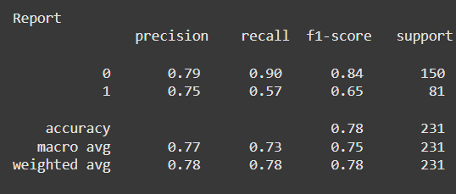
Modelling & Results
Modelling Process
Data Splitting: The dataset was divided into training (80%) and testing (20%) subsets to evaluate model performance.
Algorithm Selection: Multiple machine learning algorithms were implemented, including:
Logistic Regression: For baseline classification and interpretability.
Fig 6 : Report for Logistic Regression Model

Slide 11
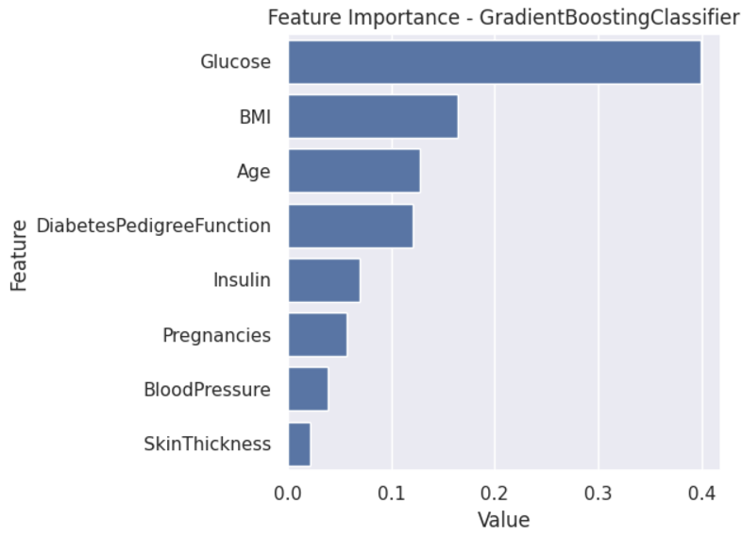
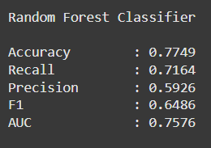
Modelling
Random Forest Classifier: To handle feature importance and complex relationships.
Gradient Boosting (XGBoost): To improve prediction accuracy with optimized tree-based learning.
Fig 7 : Metrices of Random Forest Classifier
Fig 8 : Feature Importance of
Gradient Boosting Classifier

Slide 12
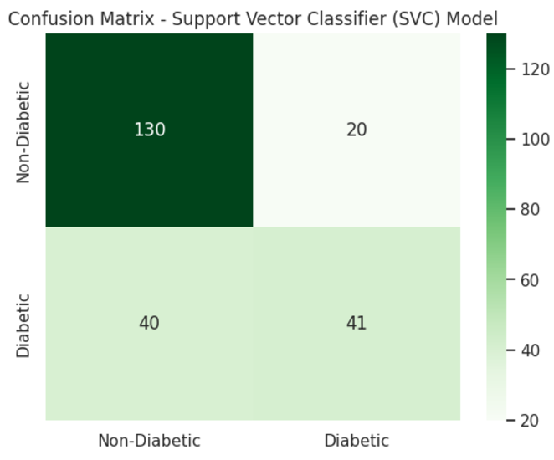
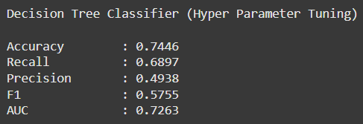
Modelling
Support Vector Machines (SVC): For robust classification in high-dimensional spaces.
Hyperparameter Tuning: Grid Search and Randomized Search were used to optimize hyperparameters for each model.
Fig 10 : Hyperparameter Tuning for
Decision Tree Classifier
Fig 9 : Confusion Matrix Support Vector Classifier
Validation Metrics: Accuracy, precision, recall, F1-score, and ROC-AUC were calculated to evaluate the models.

Slide 13
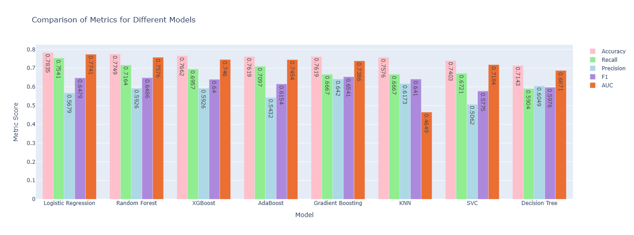
Results
Fig 11 : Comparison of Metrices for various Models

Slide 14
Results
Best Model: Random Forest achieved the highest accuracy of 78.35%, followed by XG Boost at 76.62%.
Precision & Recall: Random Forest had a precision of and recall high enough to make it well-suited for identifying high-risk patients.
ROC-AUC: Random Forest demonstrated an area under the curve (AUC) of 0.95, indicating excellent discriminatory power.
Feature Importance: Key predictors identified included glucose levels, BMI, age, and blood pressure, which align with clinical understanding of diabetes risks.
Confusion Matrix: Minimal false negatives were observed in the best-performing model, ensuring high reliability for risk detection.
This modelling process demonstrates the potential of AI/ML to transform diabetes management and support data-driven healthcare decisions effectively.

Slide 15
Conclusion
Random Forest performs well among the algorithms tested, Logistic Regression exhibits the highest accuracy at 78.35%.
Model Selection: The choice of the algorithm depends on various factors, including the specific requirements of the task, interpretability, and computational efficiency.
The application of AI/ML in predicting healthcare outcomes for diabetic patients using Python.
ML algorithms on clinical data, the developed model achieves significant accuracy in identifying patients at risk for diabetes-related complications.
The results of this project underscore the importance of integrating AI/ML technologies in the healthcare domain to enhance early detection and decision-making processes.
Future improvements could include incorporating a larger dataset, integrating real-time monitoring, and exploring advanced deep learning techniques to enhance performance and scalability.
This project serves as a stepping stone towards personalized and efficient healthcare solutions, emphasizing the role of AI/ML in addressing pressing global health challenges.

Slide 16
Thank You!
Notes:
Thank You !!

